Slide 1
Epidemic broadcast
Marco Pinna
Yuri Mazzuoli
Rambod Rahmani

Slide 2

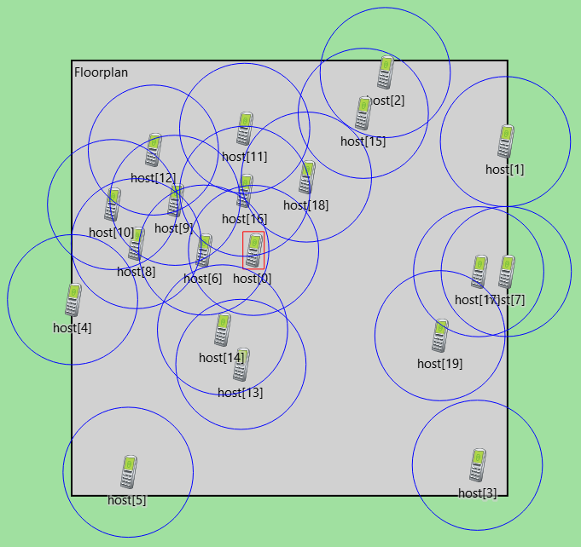
General scenario
N users dropped randomly on a floorplan
One of them produces a message, which should reach everyone as soon as possible
Communications are slotted
Every user has a transmission radius R
Each user relays the message once with probability p and stops
Two or more transmission to the same receiver during the same slot produce a collision (receiver will not be able to decode the message correctly)

Slide 3
Overview
METRICS
PARAMETERS
Broadcast radius R
Transmission probability p
Number of users N
Length of the side of the floorplan L
"Aspect ratio" of the floorplan a
Density of users per square metre d (function of N, L and a)
1 m - 20 m
0.1 - 0.9
Broadcast time T
Coverage C
Number of collisions X
N = 100 L = 100 m a = 1

Slide 4
Modelling
Graph modelling and graph properties useful for the study

Slide 5
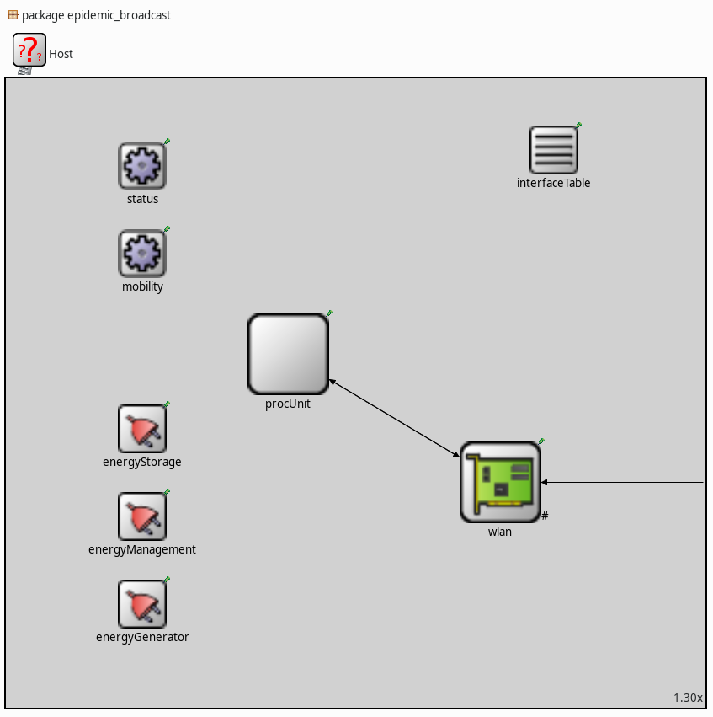
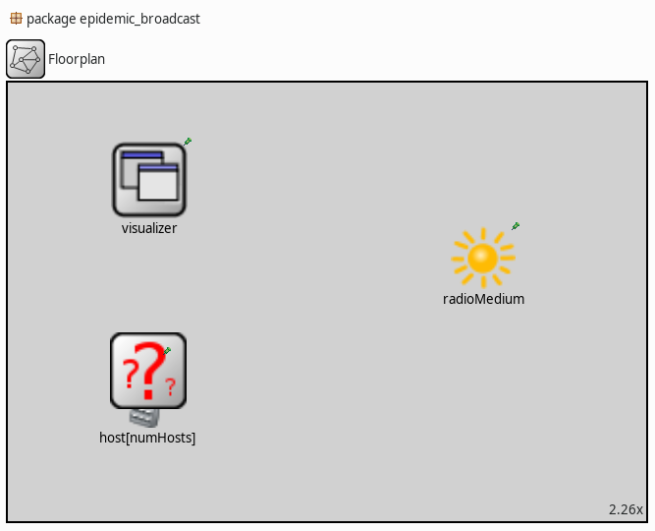
Omnet++ Simulator
INET Framework for networking models

Slide 6
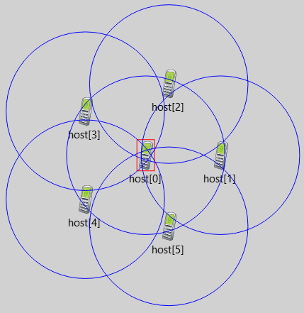
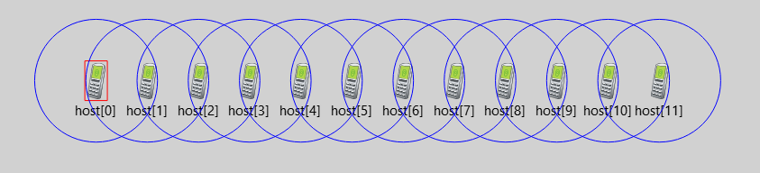
Simulator validation
Two fixed configuration for testing, with predictable outcomes
Star 5 to 1
Single queue

Slide 7
Simulation parameters
seed-set = ${repetition}
num-rngs = 3
Floorplan.host[*].procUnit.rng-0 = 0
Floorplan.host[*].mobility.rng-1 = 1
Floorplan.host[*].mobility.rng-2 = 2
repeat = 200
Floorplan.host[*].mobility.initialX = uniform(0m, 100m, 1)
Floorplan.host[*].mobility.initialY = uniform(0m, 100m, 2)
Floorplan.host[*].procUnit.p = ${p = 0.1..1 step 0.1}
Floorplan.host[*].wlan.radio.transmitter.communicationRange = ${R = 1..20 step 1}m
Floorplan.numHosts = 100

Slide 8
Results coverage

Slide 9
Results collisions

Slide 10
Results duration

Slide 11
Performance optimization

